Slide 1

Welcome! We start in 3 minutes:
5
Op je vaste plek zitten
Telefoon / tablet in je tas
Boeken op de tafel
Tassen op de grond
Pen bij de hand
Praten: alleen zachtjes
Woorden leren uit je tekst boek /
Opgaves maken.
5
1
2
3
4

Slide 2
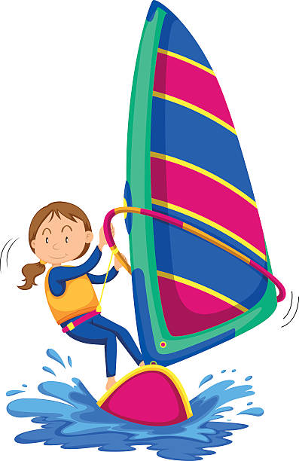
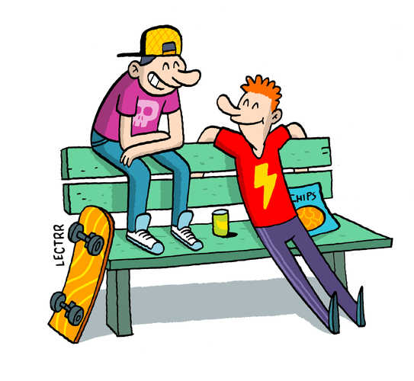
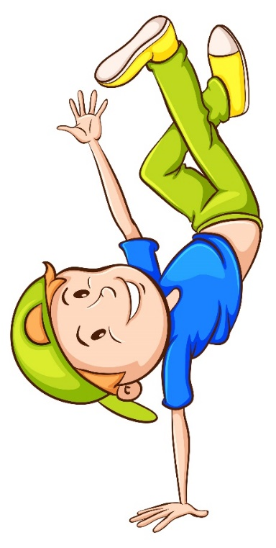
What are they doing?

Slide 3
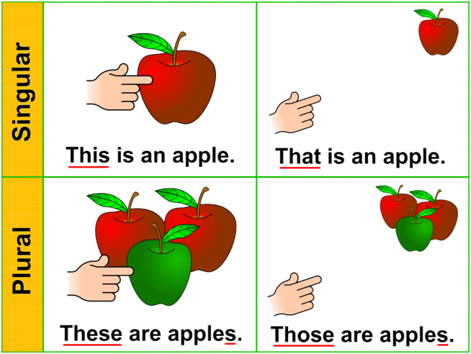
One / Ones
This one
That one
These ones
Those ones

Slide 4
TRY IT YOURSELF:
Fill in one or ones
At the market:
Jake: A small apple and two large …, please. I would also like two melons: that … and this … .
Stall holder: OK. How about some grapes? Do you like green grapes or purple …?
Jake: Can I try a green …? Great! I´ll take the green … over there.

Slide 5
KEY:
At the market:
Jake: A small apple and two large ones, please. I would also like two melons: that one and this one.
Stall holder: OK. How about some grapes? Do you like green grapes or purple ones?
Jake: Can I try a green one? Great! I´ll take the green ones over there.

